Slide 1
Solar Program Updates
Trade Ally Forums
November 2017

Slide 2
Agenda
RETC dates to remember
Getting prepared for 2018
Technical training
Program updates and process enhancements
2018 draft budget
Feedback on program ideas

Slide 3
Residential Energy Tax Credit Dates to Remember
Notes:
This slide will be used for all roundtables.

Slide 4
Residential Energy Tax Credit Timeline
Contract signed with Deposit | December 31, 2017
Energy Trust & ODOE Applications Submitted in PowerClerk | December 31, 2017
Project Operational and Jurisdictional Inspection Complete | April 1, 2018
Application Electronically Signed | June 1, 2018
Notes:
Going to cover four areas
Overarching themes
Reflective in initiatives and offers we will roll out this year
Consumer Protection and QC
Soft cost reduction
Solar systems to provide additional value beyond generation
Advanced technology for solar

Slide 5
Get Prepared for 2018!
Notes:
This slide will be used for all roundtables.

Slide 6
Solar Marketing Training Series
1.
2.
3.
4.
6-part training series
Webinars, podcasts, blog articles and worksheets
Available on heatspring.com
5.
6.
www.energytrust.org/businessdevelopment
Notes:
Now is the time to plan for 2018! The solar marketing training series is a 6-part program that allows solar contractors to Take Stock, Map out a Strategy and Effectively
Another initiative is Solar Marketing Training Series
Through Heatspring
Go through training annually – helps plan marketing campaigns and goals for year

Slide 7
Financial Management Consulting
The following services are eligible for a 50 percent cost match:
Complete Financial Management Assessment
Hourly Financial Consulting
Bimonthly “Remote CFO” Meetings
www.energytrust.org/businessdevelopment
Notes:
Energy Trust has contracted with Kendrick Business Services to offer solar trade ally contractors up to $5,000 per year to use toward financial assessment and management services for their business. As part of our ongoing soft cost reduction effort and to help solar trade allies take advantage of these valuable business development resources, Energy Trust can offset half the cost of the services.
Phase 2 of an offer from last year, more limited
Complete Financial Management Assessment—A comprehensive Quickbooks file assessment and review of the company’s financials. After this assessment, the trade ally will be provided a report and a follow-up meeting to review the assessment and create an action plan to define goals and timelines for improvements identified during the assessment. The written evaluation will cover topics relevant to the solar installation industry, including job costs, project tracking, reporting and overall business financial management, as well as samples for best practices in the industry. Cost to Trade Ally: $500 after Energy Trust’s 50 percent cost match
Hourly Financial Consulting—Upon completion of the assessment, Kendrick Business Services can work with Solar trade allies on optimization and cleanup of QuickBooks data to achieve goals defined during the assessment Cost to Trade Ally: $100 per hour after Energy Trust’s 50 percent cost match
Remote CFO Meetings—After identifying gaps during the financial management assessment and taking action to address them, solar trade allies can take advantage of a bimonthly “Remote CFO” service to continue making process toward strategic goals and provide professional financial advice that is catered to your specific business needs. Cost to Trade Ally: $300 per meeting after Energy Trust’s 50 percent cost match

Slide 8
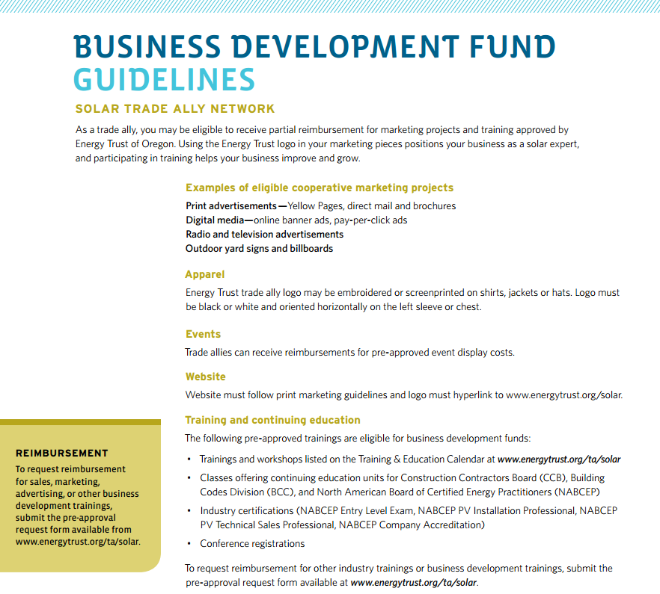
Business Development Fund
www.energytrust.org/businessdevelopment
Notes:
As always we have business development funds, have information up front to assist.
If you have a qualifying marketing campaign or training or certification, we can support after pre-approval submittal.
Star rating impacts levels of benefits you can receive.
Can assist in person.

Slide 9
Business Development Fund
Cooperative marketing
Apparel
Events

Slide 10
Technical Training
Notes:
This slide will be used for all roundtables.

Slide 11
Oregon Solar Energy Conference
450 Attendees
143 Companies
Expanded Solar Contractor Day
Save the Date: May 1–3, 2018
oregonsolarenergyconference.com
Notes:
Deadline to sign up for early bird lower rates

Slide 12
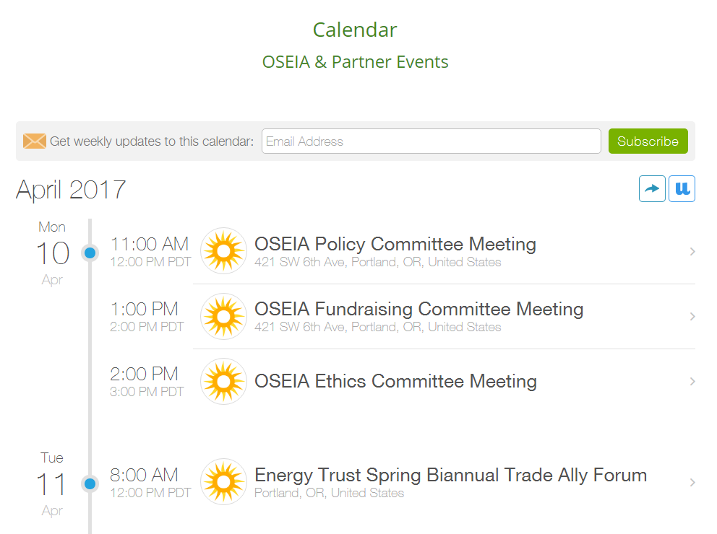
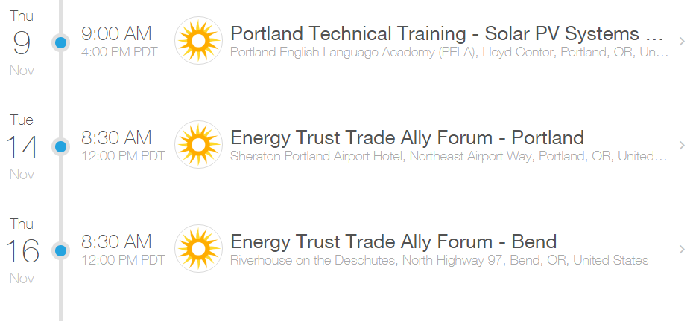
OSEIA Statewide Technical Training
Notes:
Energy Trust contracts with OSEIA to provide training
Best way to find out is to sign up for calendar

Slide 13
Program Updates and Process Enhancements
Notes:
This slide will be used for all roundtables.

Slide 14
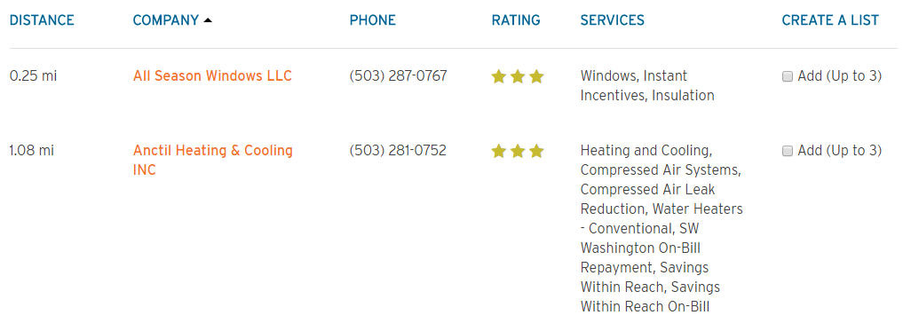
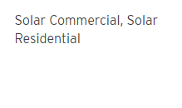
Solar Trade Ally Rating System
Customer View
Review previous 12-months of activity
Score updated quarterly
Detailed rating report generated
Customer Service Program Service Quality Service
All-Star Solar
(503) 555-5505
Notes:
Rating system based on CS, PS, QS
Currently visible on the website
You should have just recently received your report and star rating for the most recent rating period

Slide 15
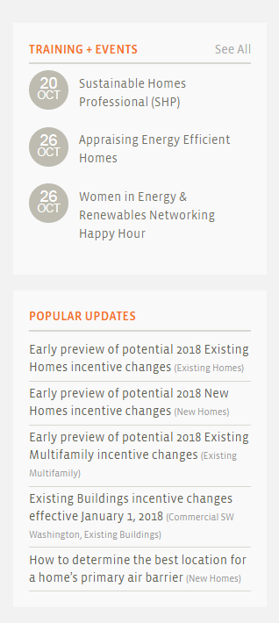
Expedited Solar Incentive Payments

Slide 16
Consumer Education & Leads
Notes:
The program will be piloting WattPlan in 2018. This will be a tool that customers throughout the state can use.

Slide 17
Consumer Education & Leads
Notes:
The program will be piloting WattPlan in 2018. This will be a tool that customers throughout the state can use.

Slide 18
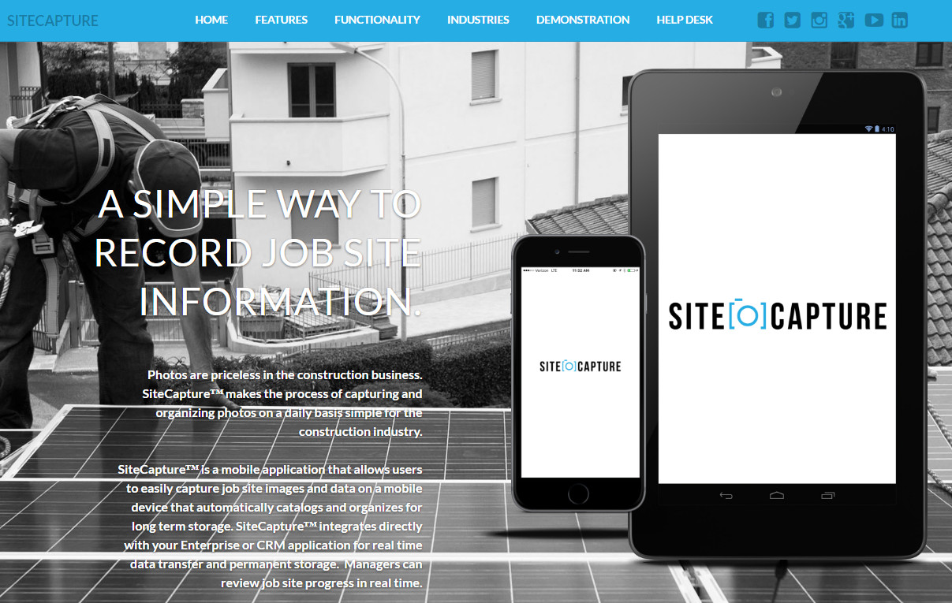
Remote Site Verification
Notes:
Energy Trust is

Slide 19
Remote Site Verification
Notes:
Energy Trust is

Slide 20
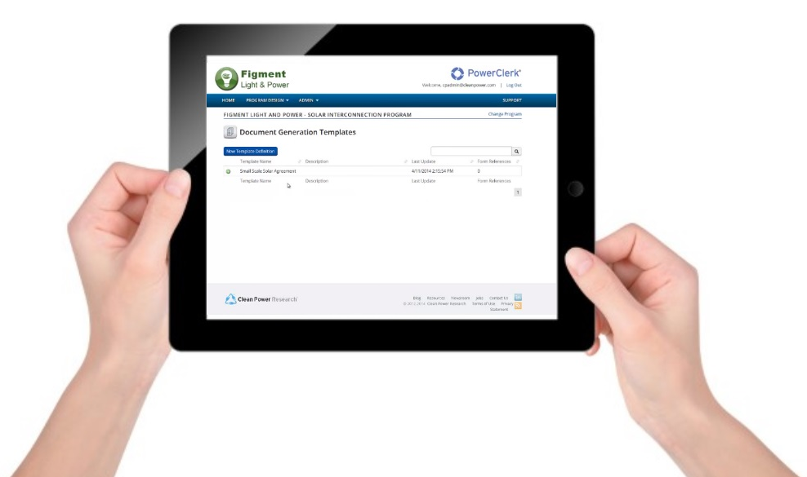
PowerClerk 2.0

Slide 21
PowerClerk 2.0

Slide 22
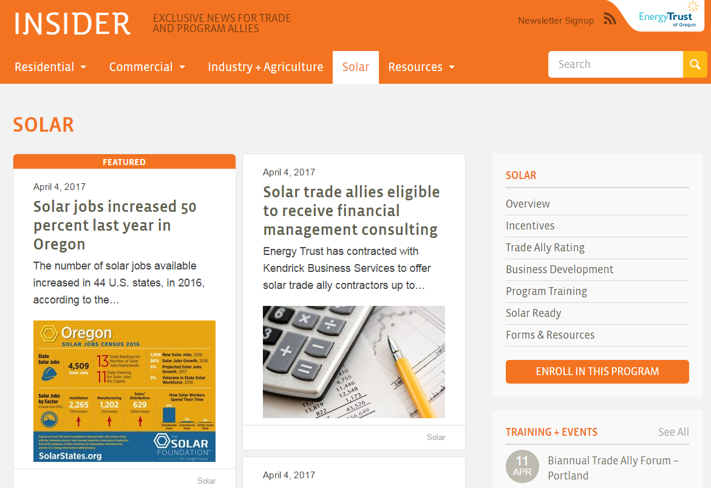
Trade Ally Website
insider.energytrust.org/solar
Notes:
The website remains the best way to get information
Be sure to sign up
Anyone in your office is also signed up
Get up to date information
1x a month

Slide 23
2018 Draft Budget
Notes:
This slide will be used for all roundtables.

Slide 24
2018 Draft Budget for New Incentives
 | PGE | Pacific Power | Total
Residential | $1.8 million | $0.9 million | $2.7 million
Business | $1.8 million | $0.9 million | $2.7 million
Solar Ready, PDA & Incentive Adders | $0.42 million | $0.25 million | $0.67 million
Total | $4.02 million | $3.42 million | $6.7 million
Notes:
Breakdown of residential and business solar incentive budget by utility
In order to support

Slide 25
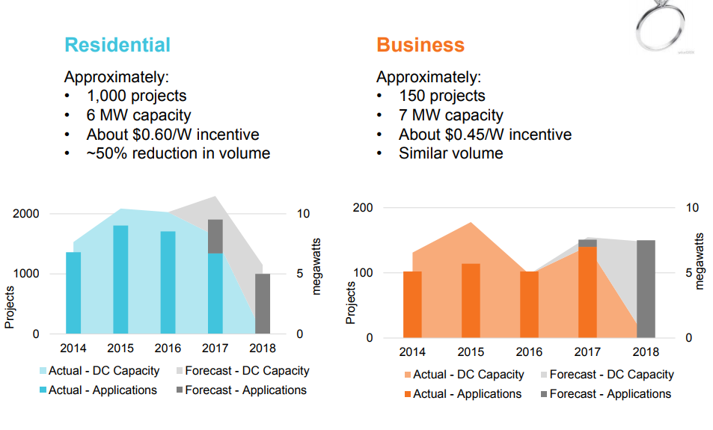
2018 Solar Forecast

Slide 26
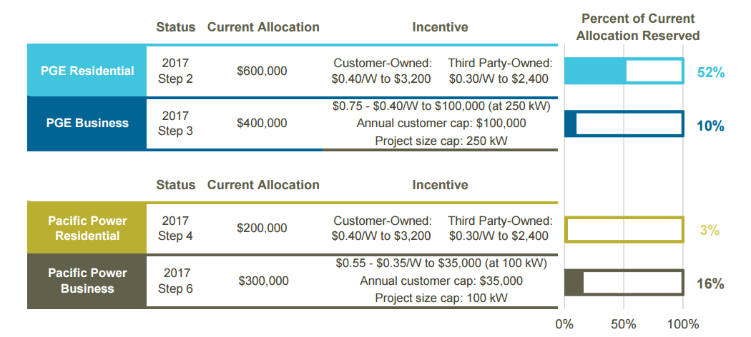
Solar Incentive Status Report
Monitor percentage reserved in current step
WAITING ON UPDATED IMAGE
www.energytrust.org/solarstatus
Notes:
It is the program’s goal to telegraph transparent, regular and incremental incentive reductions to meet the increasing demand for solar in Oregon.
Due to budget constraints and in order to support as many projects as possible we made the decision to focus on small to mid-size commercial projects.
Remains goal to be transparent
Provide info on incentive changes with advance notice when possible

Slide 27
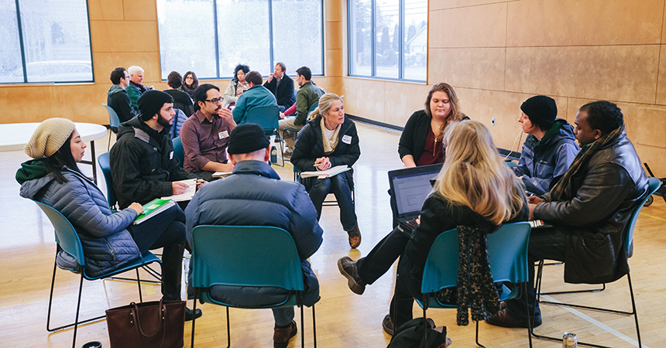
Solar for Low Income Communities
Oregon awarded $1.7 million from DOE SunShot to develop strategies that will bring solar to more low- and moderate-income residents.
Notes:
Example of a way that there can be greater access and more customers benefit from solar
Oregon, five other states and the Clean Energy States Alliance were awarded $1.7 million from SunShot to develop strategies that will bring solar to more low- and moderate-income residents. ODOE and Energy Trust are convening a working group that includes with energy experts and organizations that serve low- and moderate-income Oregonians to identify barriers and to develop and implement effective strategies.
In February, Energy Trust sponsored four Solar for Oregon Communities workshops in Roseburg, Redmond, Hood River and Portland to gather input and ideas about ways to reach and serve more customers with solar.
Since then Energy Trust has begun convening the Low- to Moderate-Income (LMI) Solar Working Group to meet each month and talk through some of the challenges and opportunities that LMI Solar embodies. The group is made up of nonprofits, community organizations, utilities, developers, job training programs and more. The group will be publishing a list of recommmendations for LMI solar in Oregon early next year.

Slide 28
Trade Ally Feedback
Notes:
The program is generating a list of questions to get feedback from the trade ally group on.

Slide 29
Questions?
Jeni Hall
Sr. Project Manager ̶ Solar
jeni.hall@energytrust.org
503.459.4075

